Slide 1
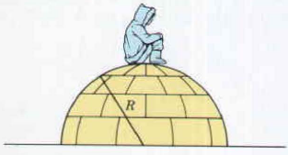








1st Midterm Exam
Centripetal acceleration
Conservation of energy
Q1. (a) (10pts) An Eskimo child slides on an icy (frictionless) hemispherical dome of radius R.
She starts with a negligible speed at the top. At what angle θ to the vertical does she lose contact with
the surface?
She loses contact with the surface when the normal
force becomes zero
(5 pts)
Conservation of energy gives
Normal force
(3 pts)
mgcosθ
θ
mg
(2 pts)

Slide 2
Similar to HW 2 – Q1
1st Midterm
Q1. (a) (10pts) An Eskimo child slides on an icy (frictionless) hemispherical dome of radius R.
She starts with a negligible speed at the top. At what angle θ to the vertical does she lose contact with
the surface?
She loses contact with the surface when the normal
force becomes zero
(5 pts)
Conservation of energy gives
Normal force
(3 pts)
mgcosθ
θ
mg
(2 pts)

Slide 3










Conservation of momentum
Work-energy theorem for many-particle systems
1st Midterm Exam
Q1. (b) (15 pts) A bomb of mass M moving with velocity 10 m/s in the +x direction explodes into two parts with masses m₁ moving in the –x direction and m₂ moving in the +x direction. The explosion supplies an additional 150 J in the total kinetic energy. Given M = 3 kg, m₁ = 1 kg, and m₂ = 2 kg, please find the speed of m₁ and m₂.
From the momentum equation
(5 pts)
and the energy equation
(5 pts)
✔
(5 pts)

Slide 4
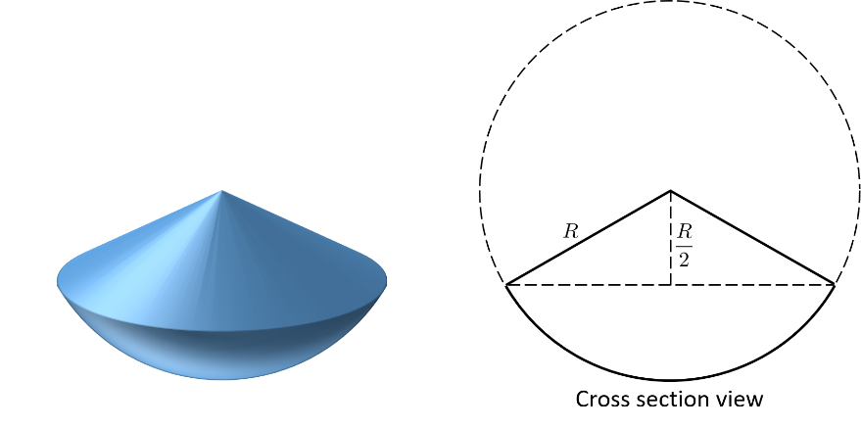















1st Midterm Exam
Center of mass
Operation of integration
Q1. (c) (25 pts) Find the center of mass of the following solid object which has a uniform density ρ. That is to find the height of the CM relative to the peak. (Show details of your calculations to receive full credits).
The object is composed of a solid cone and a solid round cap.
For the upper solid cone, let’s pick the peak as y =0.
(5 pts)
For lower solid cap, let’s pick the peak as y =0.
(5 pts)
Therefore,
The mass ratio is
(10 pts)
(5 pts)

Slide 5



1st Midterm Exam
Special relativity
Time dilation
Length contraction
Q2. (25 pts) A planet is located 18 light years away from Earth according to an observer on the Earth frame. If we plan to send a spaceship travelling at 0.6 c to explore the alien planet, please answer the following questions.
(a) How long will the journey take according to the astronauts on the spaceship?
(4 pts)
(b) What is the distance between the Earth and the planet in the spaceship's frame?
(4 pts)
(c) The observer on Earth is playing his stopwatch and recording a period of time T_{E}. According to the astronaut on the spaceship, the recorded time should be longer or shorter than T_{E}.
(4 pts)
T_{E} is the proper time. Therefore, longer.
(d) The astronaut on the spaceship is playing her stopwatch and recording a period of time T_{S}. According to the observer on Earth, the recorded time should be longer or shorter than T_{S}.
(4 pts)
T_{S} is the proper time. Therefore, longer.

Slide 6







1st Midterm Exam
Not really related to special relativity
(e) Let's assume that the spaceship at this moment is at a distance X away from the planet (seen by Earth frame), and the astronaut shoot a light toward the alien planet. Assume the light would reflect right back to the spaceship, how long does it take for the light to complete its trip returning to the spaceship according to the Earth frame?
In Earth frame, the time it takes the light to go from the spaceship to the alien planet is
(3 pts)
In Earth frame, at this moment the distance between the spaceship and the alien planet is
(3 pts)
In Earth frame, the time it takes the light to go from the alien planet to the spaceship is
Therefore,
Alien Planet
(3 pts)

Slide 7





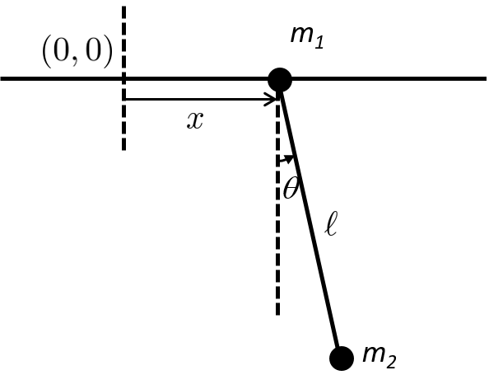







1st Midterm Exam
How to take differential & derivative
Kinetic energy and potential energy
Q3. (45 pts) A simple pendulum of mass m₂, with a mass m₁ at the point of support which can only move horizontally on a frictionless track lying in the plane in which m₂ moves as shown in the figure below. The system is placed in a uniform gravitational field . The length of the rod is and its mass is negligible.
(a) (15 pts) Write down the kinetic energy and the potential energy of the system in the inertial frame in terms of and .
(7 pts)
(3 pts)
(5 pts)

Slide 8
1st Midterm Exam
Conservation laws
Q3. (45 pts) A simple pendulum of mass m₂, with a mass m₁ at the point of support which can only move horizontally on a frictionless track lying in the plane in which m₂ moves as shown in the figure below. The system is placed in a uniform gravitational field . The length of the rod is and its mass is negligible.
(b) (10pts) Write down all conserved quantities related to momentum and energy, and explain why these quantities are conserved.
The x-component of the total momentum is conserved, since there is
no external force acting in the x-direction.
(3+2 pts)
The total energy is conserved, since gravitational force is a conservative force.
(3+2 pts)

Slide 9





1st Midterm Exam
Newton’s 2nd law
Q3. (45 pts) A simple pendulum of mass m₂, with a mass m₁ at the point of support which can only move horizontally on a frictionless track lying in the plane in which m₂ moves as shown in the figure below. The system is placed in a uniform gravitational field . The length of the rod is and its mass is negligible.
(c) (20 pts) In the inertial frame, formulate the equations of motion for m₂ in the radial and tangential direction, respectively. (DO NOT solve it).
Take one more time the time derivative to obtain the acceleration
(5 pts)
(5 pts)
(5 pts)
(5 pts)

